Slide 1

MULTIUSER DETECTION
IN A DYNAMIC ENVIRONMENT
EZIO BIGLIERI
(work done with Marco Lops)
USC, September 20, 2006

Slide 2
Introduction
and
motivation

Slide 3
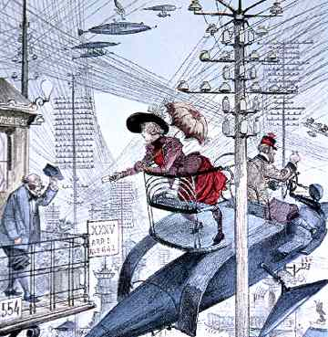
mobility
&
wireless
(“La vie electrique,” ALBERT ROBIDA,
French illustrator, 1892).

Slide 4
environment:
static, deterministic

Slide 5
environment: static, random

Slide 6
environment: dynamic, random

Slide 7
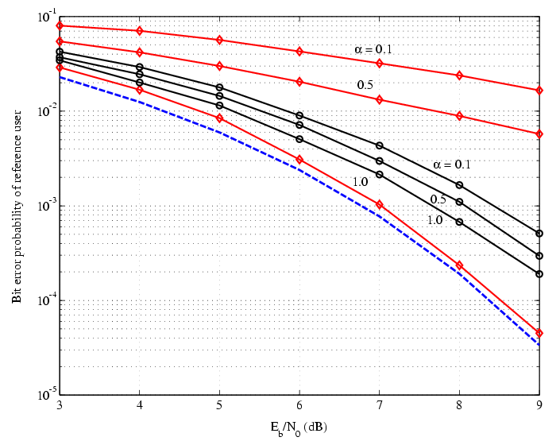
Static, random channel, 3 users:
Classic ML vs. joint ML detection of data and # of interferers

Slide 8
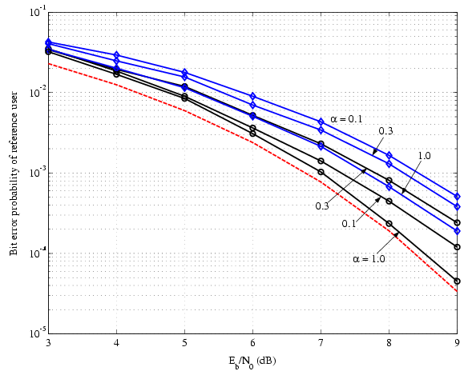
Static, random channel, 3 users:
Joint ML detection of data and # of interferes vs. MAP

Slide 9
lesson learned
MUD receivers must know the number of interferers,
otherwise performance is impaired.
Introducing a priori information about
the number of active users improves
MUD performance and robustness.
A priori information may include activity factor.
A priori information may also include
a model of users’ motion.

Slide 10
previous work
Previous work (Mitra, Poor, Halford, Brandt-Pierce,…)
focused on activity detection, addition of a single user.
It was recognized that certain detectors
suffer from catastrophic error
if a new user enter the system.
Wu, Chen (1998) advocate a two-step
detection algorithm:
⬥ MUSIC algorithm estimates active users
⬥ MUD is used on estimated number of users

Slide 11
in our work…
We advocate a single-step algorithm,
based on random-set theory.
We develop Bayes recursions to model
the evolution of the a posteriori pdf
of users’ set.

Slide 12
Random
set
theory

Slide 13
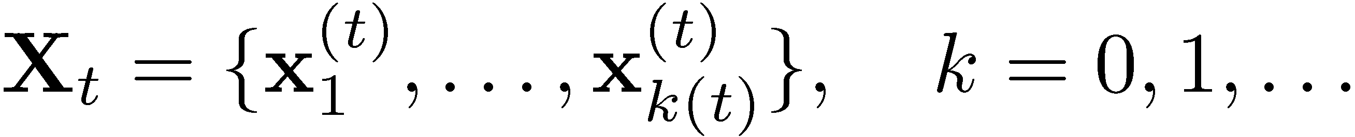
random sets
Description of multiuser systems
A multiuser system is described
by the random set
where k is the number of active interferers, and
x_{i} are the state vectors of the individual interferers
(k=0 corresponds to no interferer)

Slide 14
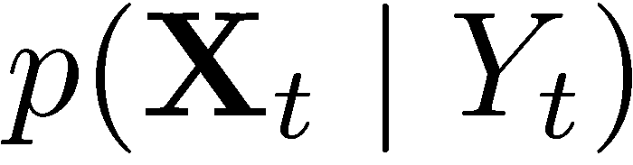
random sets
Description of multiuser systems
Multiuser detection in a dynamic
environment needs the densities
of the interferers’ set given
the observations.
“Standard” probability theory cannot
provide these.

Slide 15
enter random set theory
Random Set Theory
RST is a probability theory of finite sets that exhibit randomness not only in each element, but also in the number of elements
Active users and their parameters are elements of a finite random set, thus RST provides a natural approach to MUD in a dynamic environment

Slide 16
random set theory
Random Set Theory
RST unifies in a single step two steps that would be taken separately without it:
Detection of active users
Estimation of user parameters

Slide 17
random set theory
What random sets can do for you
Random-set theory can be applied
with only minimal (yet, nonzero)
consideration of its theoretical foundations.

Slide 18




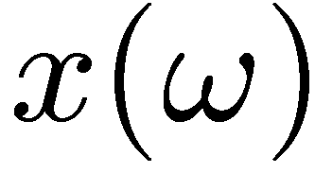
probability theory
Random Set Theory
Recall definition of a random variable:
A real RV is a map between
the sample space and the real line

Slide 19

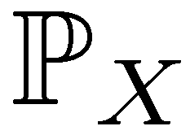
probability theory
Random Set Theory
A probability measure on Ω induces
a probability measure on the real line:
A
E

Slide 20
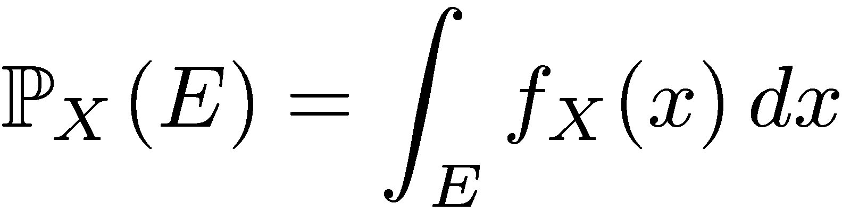
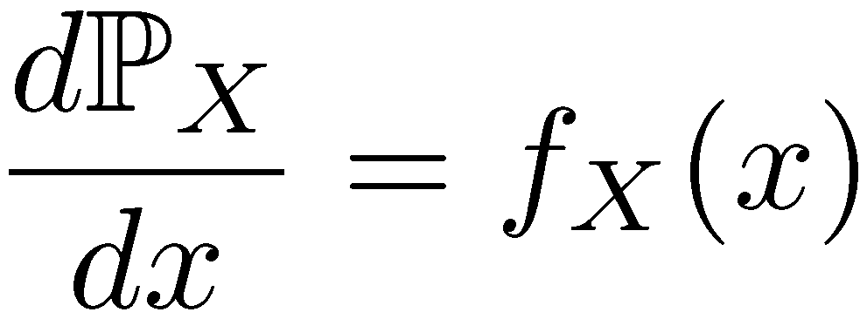
probability theory
Random Set Theory
We define a density of X such that
The Radon-Nikodym derivative of
with respect to the Lebesgue measure
yields the density :

Slide 21
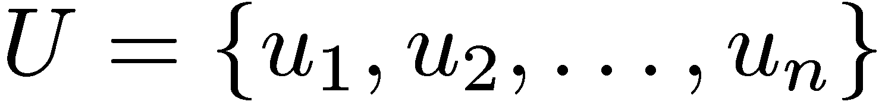
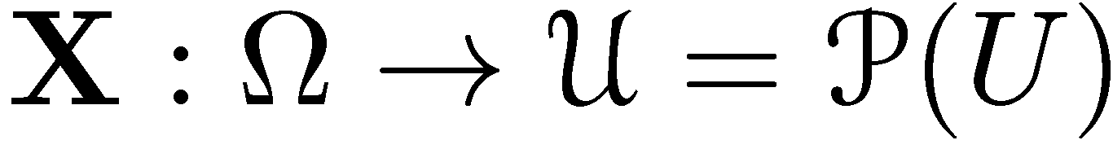
random set theory
Random Set Theory
Consider first a finite set:
A random set defined on U is a map
Collection of all subsets
of U (“power set”)

Slide 22

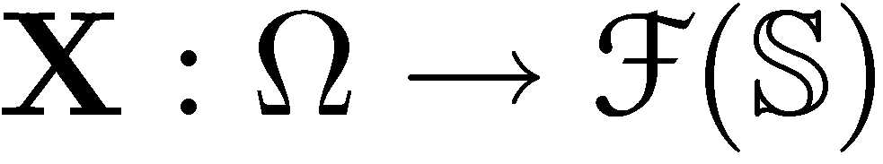
random set theory
Random Set Theory
More generally, given a set ,
a random set defined on is a map
Collection of closed
subsets of

Slide 23
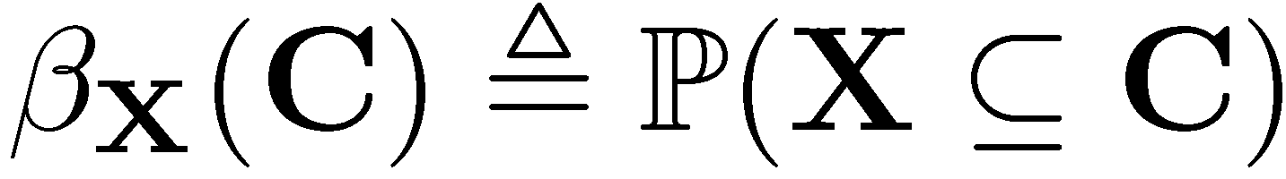

random set theory
Belief function (not a “measure”):
this is defined as
where C is a subset of an ordinary
multiuser state space:

Slide 24
random set theory
“Belief density” of a belief function
This is defined as the “set derivative” of the
belief function (“generalized Radon-Nikodym
derivative”).
Computation of set derivatives from its
definition is impractical. A “toolbox”
is available.
Can be used as MAP density in ordinary
detection/estimation theory.

Slide 25
random set theory
Example (finite sets)
Assume belief function:

Slide 26
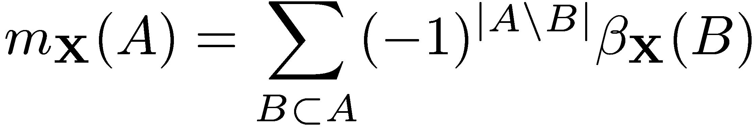
random set theory
Example (continued)
Set derivatives are given by the Moebius formula:

Slide 27
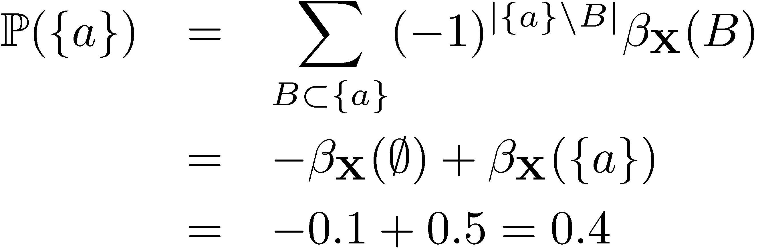
random set theory
Example (continued)
For example:

Slide 28
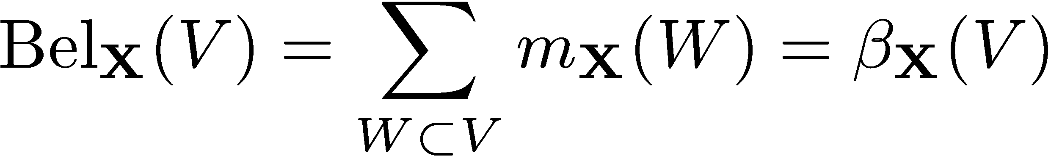
random set theory
Connections with Dempster-Shafer theory
The belief of a set V is the probability
that X is contained in V :
(assign zero belief to the empty set:
thus, D-S theory is a special case of RST)

Slide 29
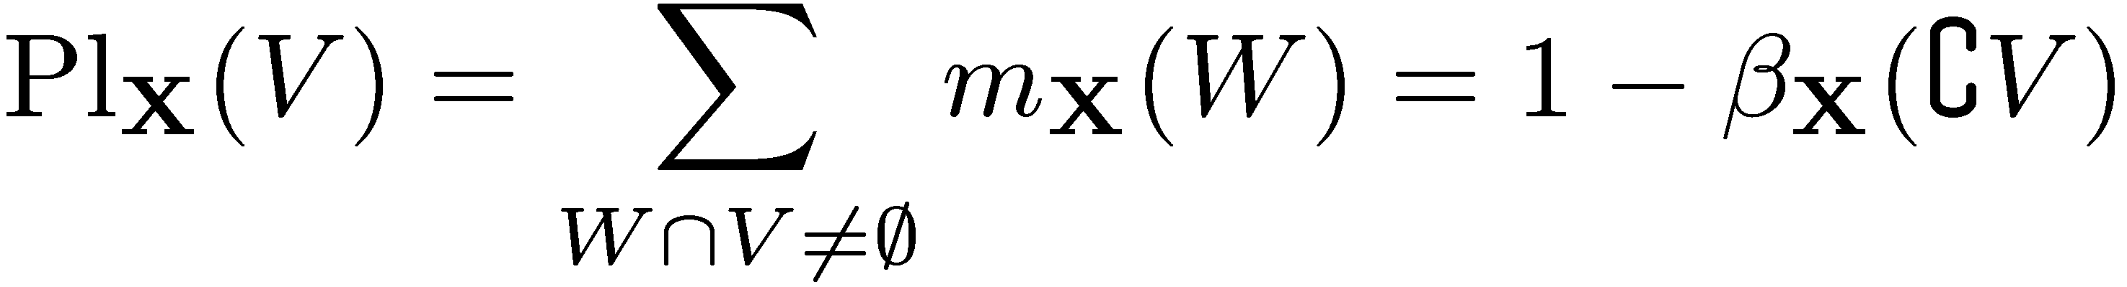
random set theory
Connections with Dempster-Shafer theory
The plausibility of a set V is the
probability that X intersects V:

Slide 30
random set theory
Connections with Dempster-Shafer theory
based on
supporting evidence
based on
refuting evidence
uncertainty
interval
0
1
belief
plausibility
plausible --- either supported
by evidence, or unknown

Slide 31
random set theory
Connections with Dempster-Shafer theory
Shafer: “Bayesian theory cannot distinguish
between lack of belief and disbelief. It does
not allow one to withhold belief from a
proposition without according that belief to
the negation of the proposition.”

Slide 32

random set theory
debate between
followers and
detractors of
RST

Slide 33
Finite
random
sets

Slide 34


finite random sets
Random finite set
We examine in particular the
“finite random sets”
finite subset of
a hybrid space
with U finite

Slide 35
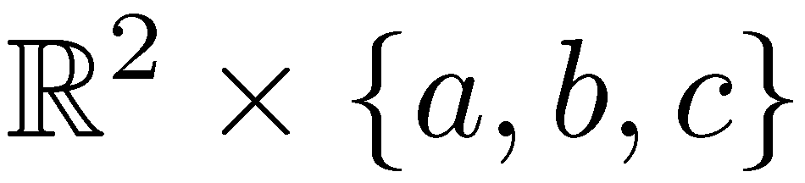
finite random sets
Hybrid spaces
Example:
a
b
c

Slide 36
finite random sets
Hybrid spaces
Why hybrid spaces?
In multiuser application, each user state is
described by d real numbers and one
discrete parameter (user signature,
user data).
The number of users may be 0, 1, 2,…,K

Slide 37
Application:
cdma

Slide 38
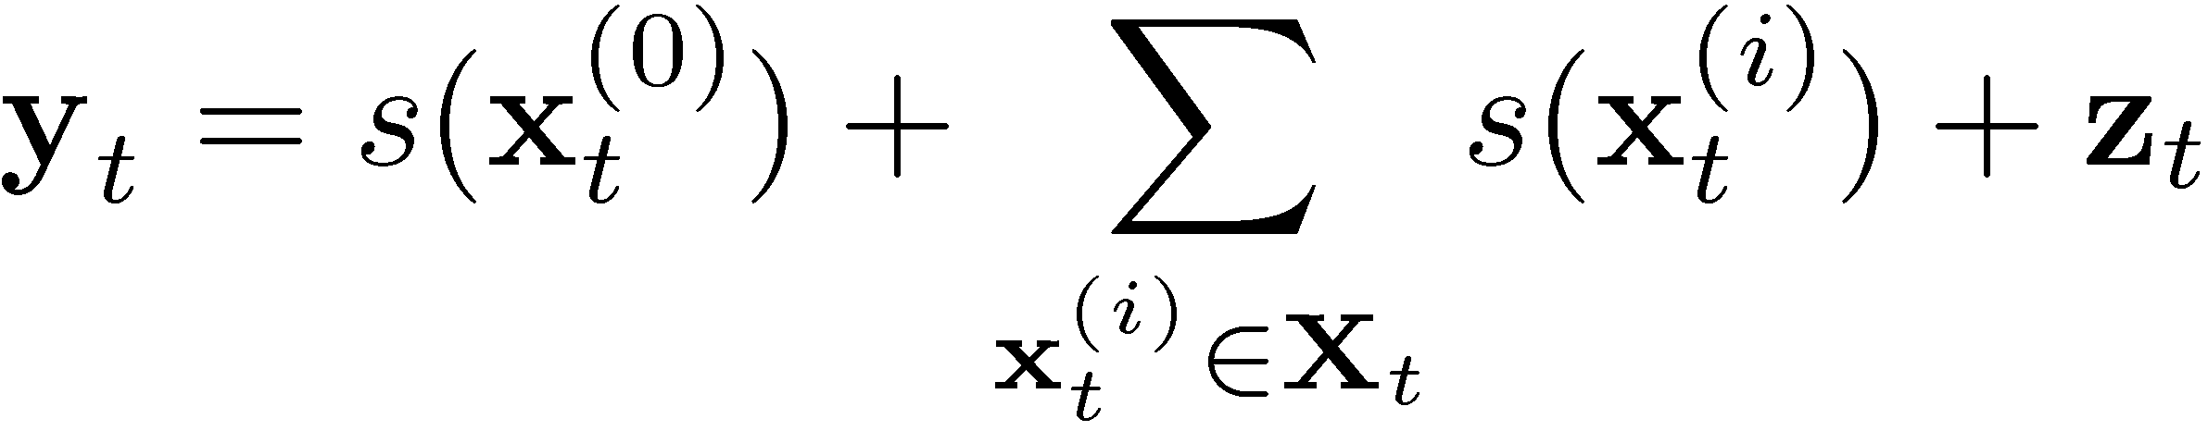
multiuser channel model
random set:
users at time t

Slide 39
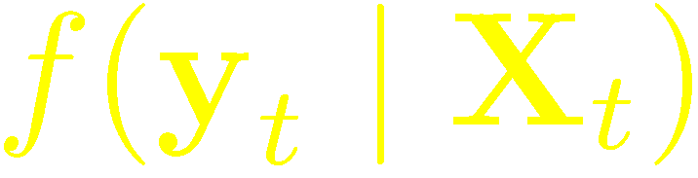
modeling the channel
Ingredients
Description of measurement process
(the “channel”)

Slide 40
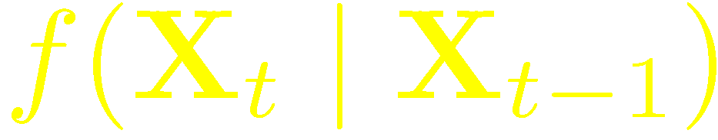
modeling the environment
Ingredients
Evolution of random set with time
(Markovian assumption)

Slide 41
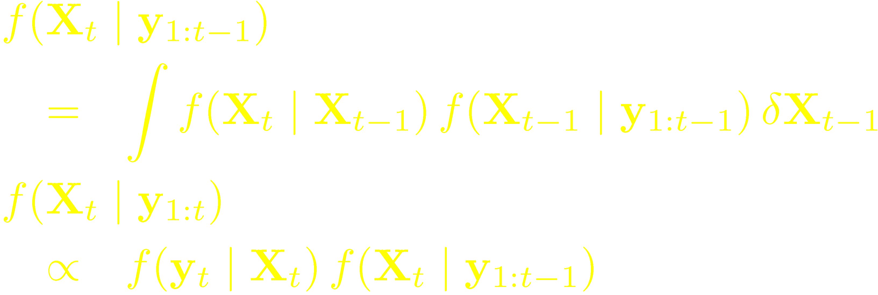
Bayes filtering equations
Integrals are “set integrals”
(the inverses of set derivatives)
Closed form in the finite-set case
Otherwise, use “particle filtering”

Slide 42
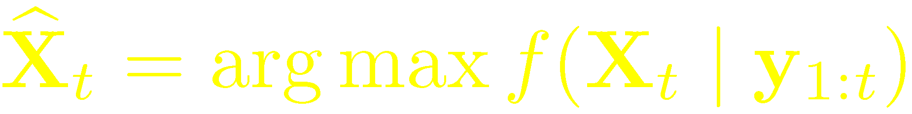
MAP estimate of random set
MAP estimate of random set
(causal estimator)

Slide 43
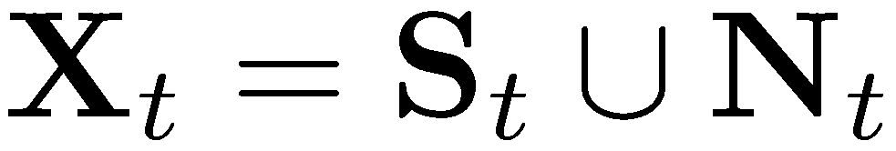
multiuser dynamics
random set:
users at time t
users surviving
from time t-1
new users
users at time t-1
new users
all potential users
surviving users

Slide 44
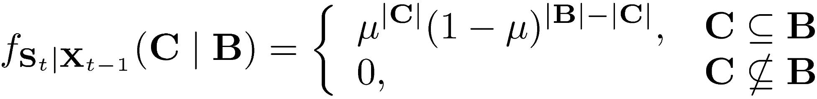
surviving users
μ = probability of persistence
B
C

Slide 45
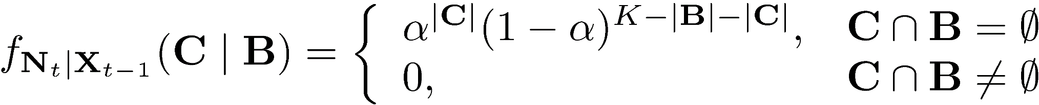
new users
α = activity factor
B
C

Slide 46
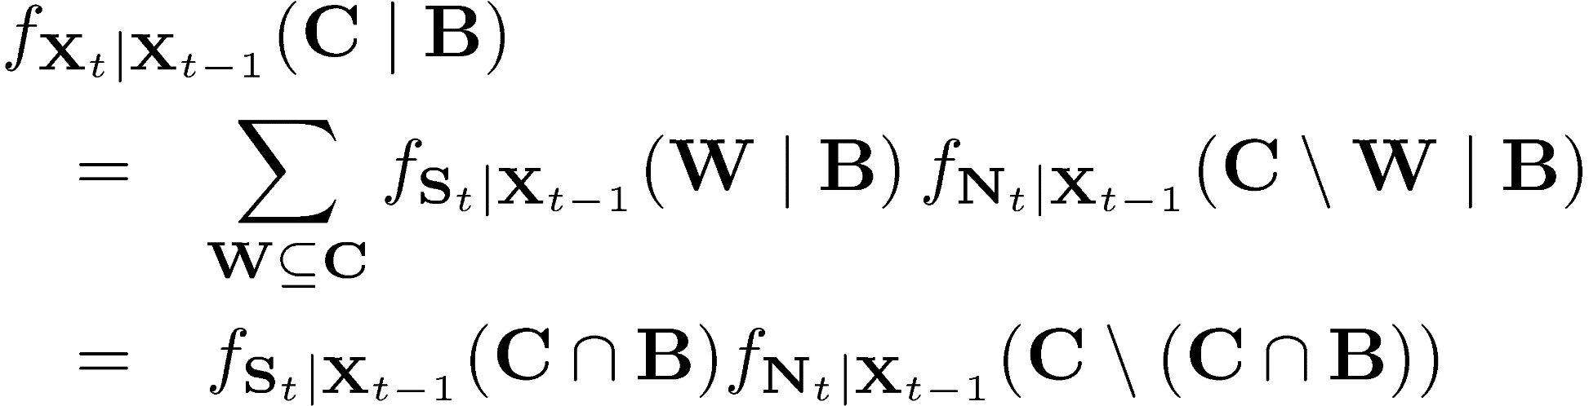
surviving users + new users
Derive the belief density of
through the “generalized convolution”

Slide 47
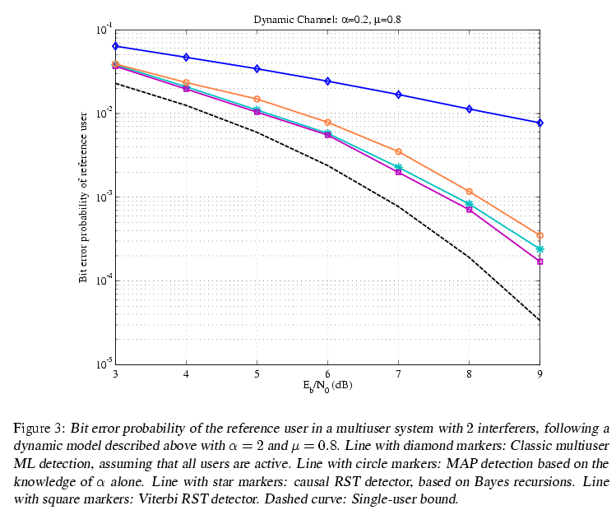

Slide 48
detection and estimation
In addition to detecting the number of
active users and their data, one may
want to estimate their parameters
(e.g., their power)
A Markov model of power evolution
is needed

Slide 49
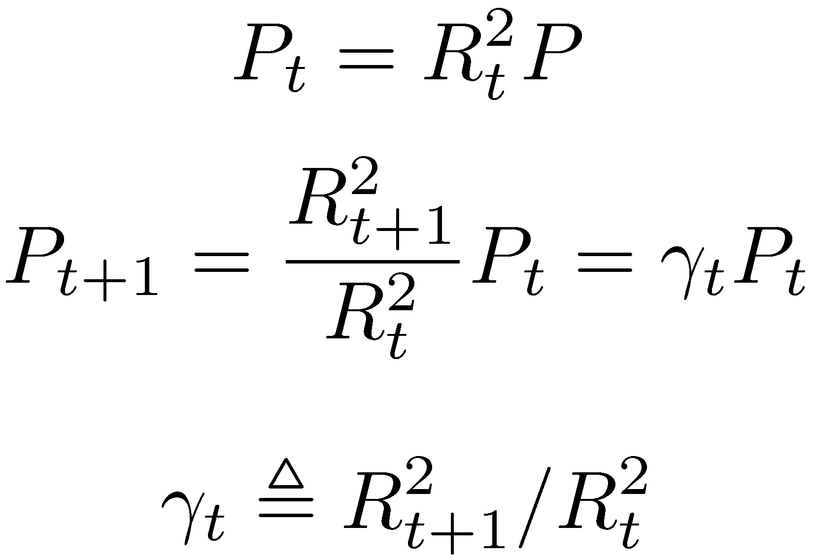
effect of fading

Slide 50
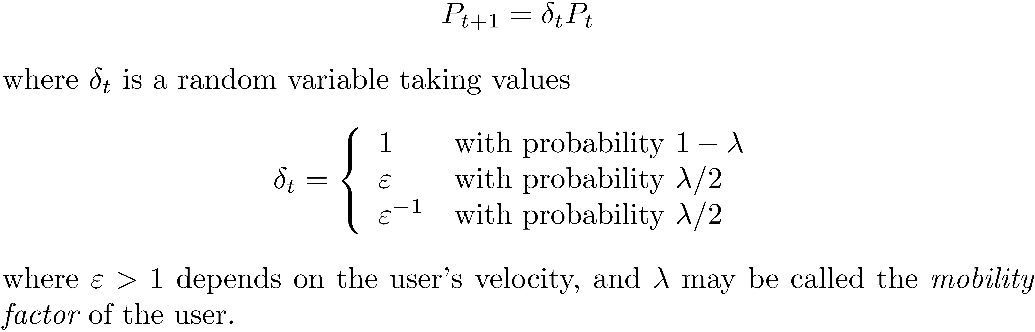
effect of motion

Slide 51
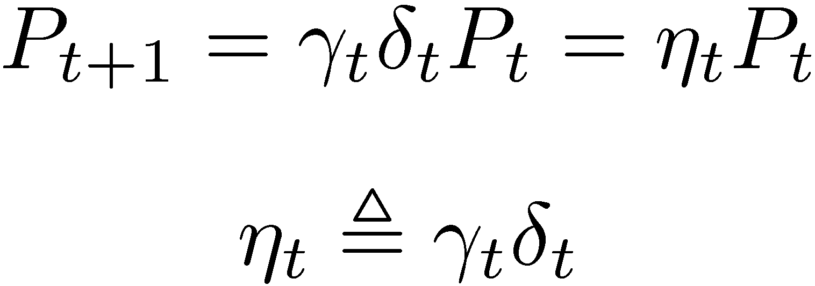
joint effects

Slide 52
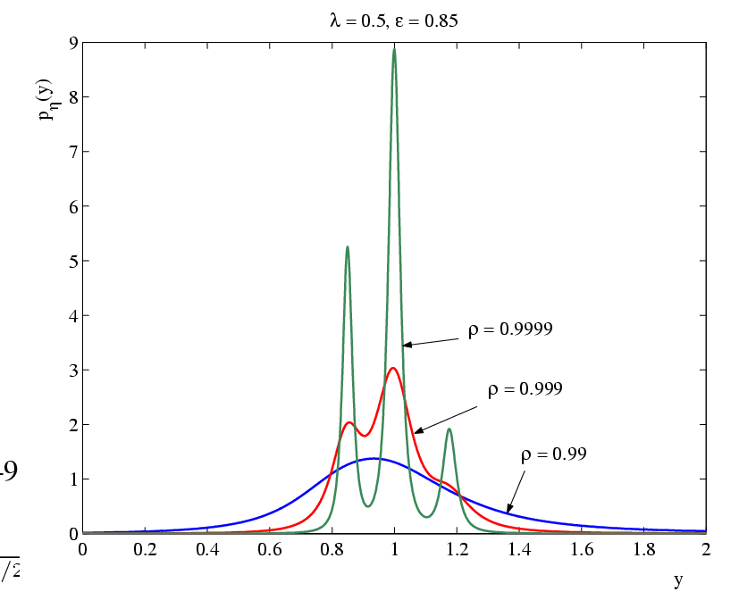
pdf of η for Rayleigh fading

Slide 53
Application:
neighbor discovery

Slide 54
neighbor discovery
In wireless networks, neighbor discovery
(ND) is the detection of all neighbors with
which a given reference node may
communicate directly.
ND may be the first algorithm run in
a network, and the basis of medium
access, clustering, and routing algorithms.

Slide 55
neighbor discovery
T_{D}
#1
#2
#3
#4
T
receive interval of reference user
transmit interval of neighboring users
Structure of a discovery session

Slide 56
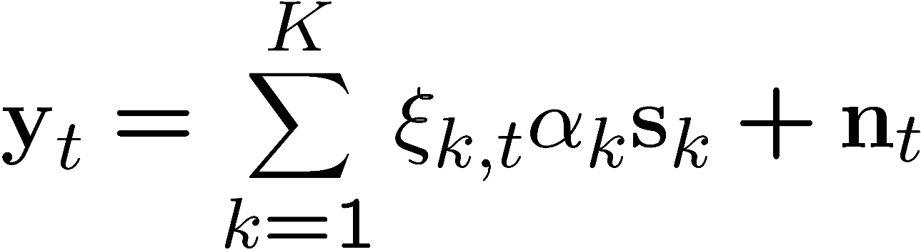
neighbor discovery
Signal collected from all potential neighbors during receiving slot t :
signature of user k
=1 if user k is
transmitting at t
amplitude of user k

